Slide 1
On amortizing convex conjugates for optimal transport
Brandon Amos • Meta AI (FAIR) NYC
http://github.com/bamos/presentations http://github.com/facebookresearch/w2ot

Slide 2
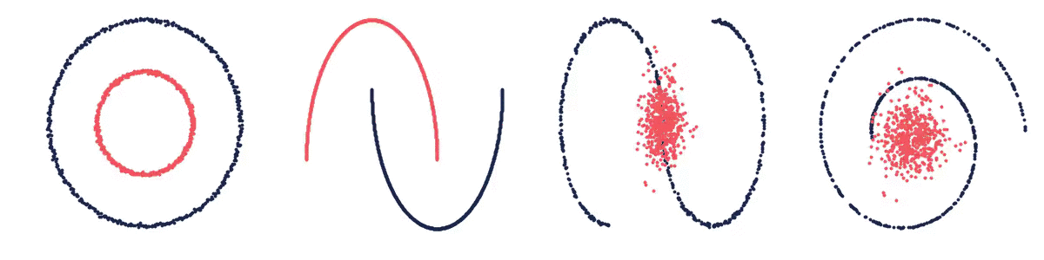
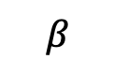
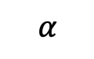

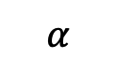
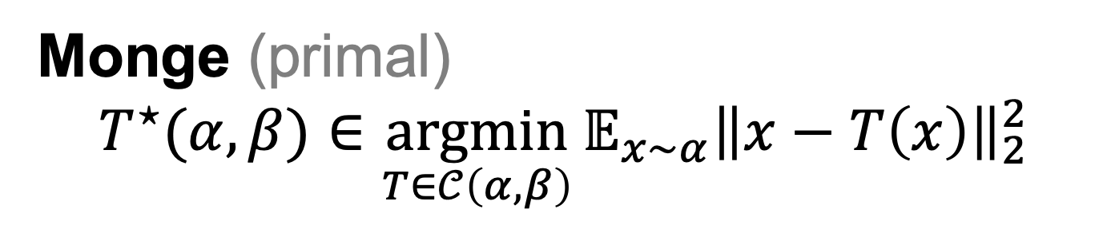
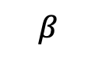
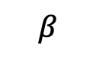
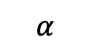
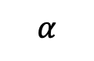
Optimal transport connects spaces
Monge (primal)
$${T^{⋆}(α, β)∈\underset{T∈𝒞\left(α, β\right)}{argmin}{𝔼_{x∼α}\left\|x−T\left(x\right)\right\|}}_{2}^{2}$$
$α,β$ are measures
$𝒞\left(α, β\right)$ is the set of valid coupling
$T$ is a transport map from $α$ to $β$
$$β$$
$$α$$
$$β$$
$$α$$
$$α$$
$$α$$
$$β$$
$$β$$

Slide 3
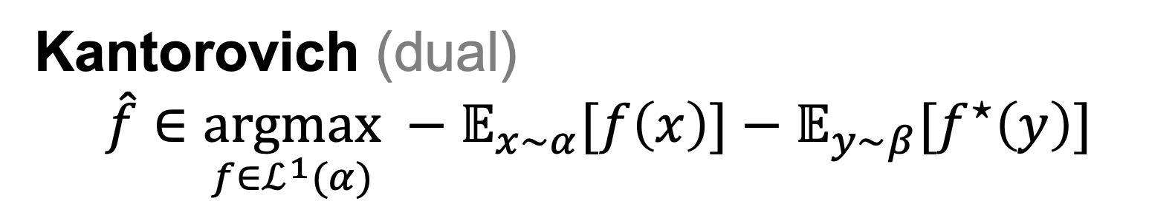
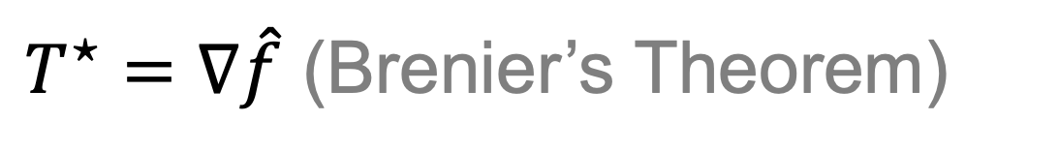
Duality and continuous OT
Monge (primal)
$${T^{⋆}(α, β)∈\underset{T∈𝒞\left(α, β\right)}{argmin}{𝔼_{x∼α}\left\|x−T\left(x\right)\right\|}}_{2}^{2}$$
$T^{⋆}=∇\hat{f}$ (Brenier’s Theorem)
Kantorovich (dual)
$$\hat{f}∈\underset{f∈ℒ^{1}(α)}{argmax} −𝔼_{x∼α}[f\left(x\right)]−𝔼_{y∼β}[f^{⋆}\left(y\right)]$$

Slide 4
Solving Kantorovich’s dual with a neural net
2-wasserstein approximation via restricted convex potentials. Taghvaei and Jalali, 2019.
Three-Player Wasserstein GAN via Amortised Duality. Nhan Dam et al., IJCAI 2019.
Optimal transport mapping via input convex neural networks. Makkuva et al., ICML 2020.
Wasserstein-2 generative networks. Korotin et al., ICLR 2020.

Slide 5
Focus: computing the conjugate
Amortization: Approximate the arginf with (another) neural network
2-wasserstein approximation via restricted convex potentials. Taghvaei and Jalali, 2019.
Three-Player Wasserstein GAN via Amortised Duality. Nhan Dam et al., IJCAI 2019.
Optimal transport mapping via input convex neural networks. Makkuva et al., ICML 2020.
Wasserstein-2 generative networks. Korotin et al., ICLR 2020.

Slide 6
Conjugate amortization loss choices

Slide 7
Wasserstein-2 benchmark results
Do Neural Optimal Transport Solvers Work? Korotin et al., NeurIPS 2021.
Takeaway: amortization choice important, fine-tuning significantly helps
HD benchmarks: Unexplained Variance Percentage (UVP, lower is better)
CelebA benchmarks: UVP

Slide 8
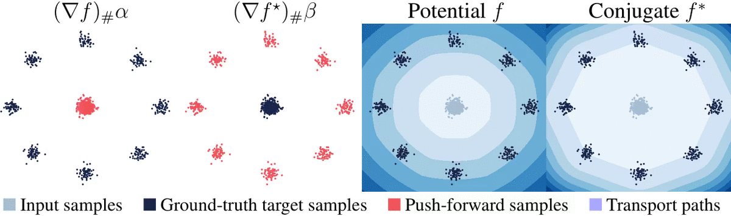

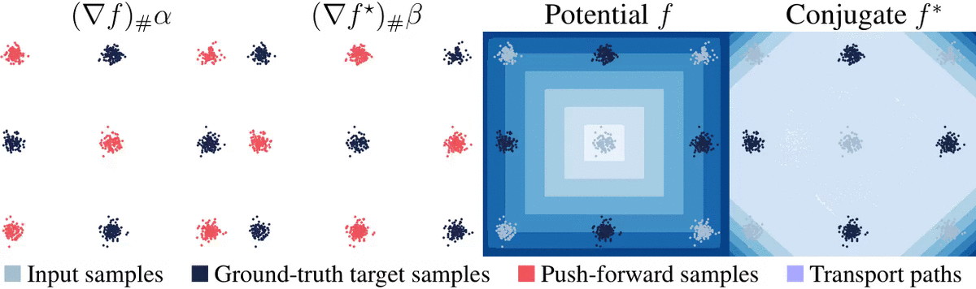
Transport between synthetic measures

Slide 9
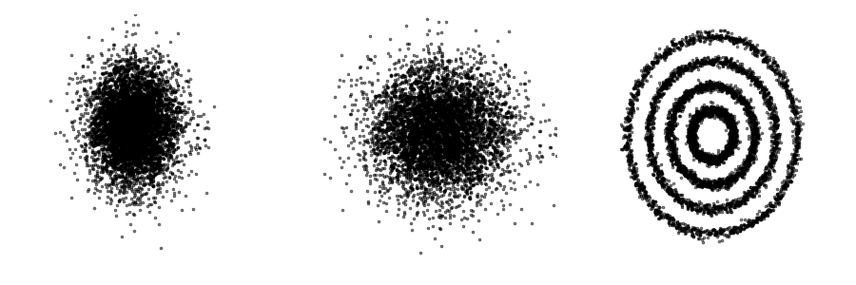

Learning flows via continuous OT
Continuous OT for flows:
Works only from samples (no likelihoods needed)
No need to explicitly enforce invertibility
No need to compute the log-det of the Jacobian

Slide 10
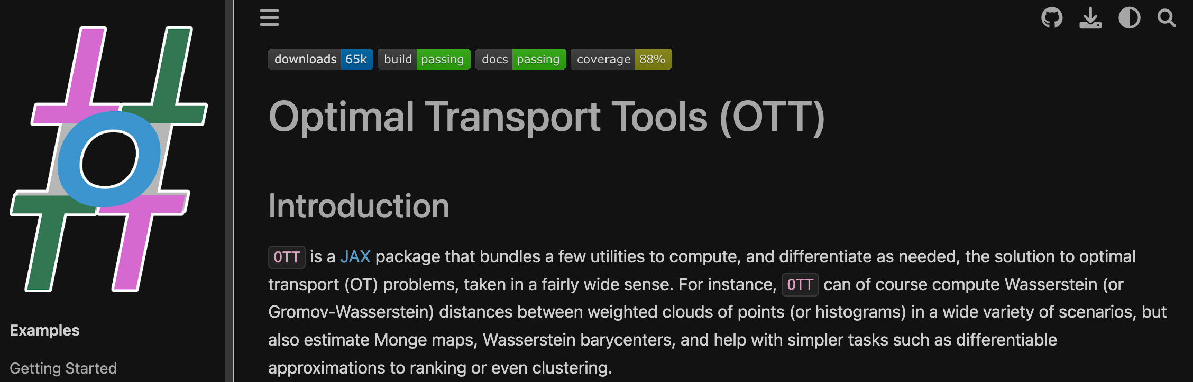
github.com/ott-jax/ott

Slide 11
On amortizing convex conjugates for optimal transport
Brandon Amos • Meta AI (FAIR) NYC
http://github.com/bamos/presentations http://github.com/facebookresearch/w2ot

